Slide 1
Data analyst :profit and sales
Vaibhavi shete

Slide 2
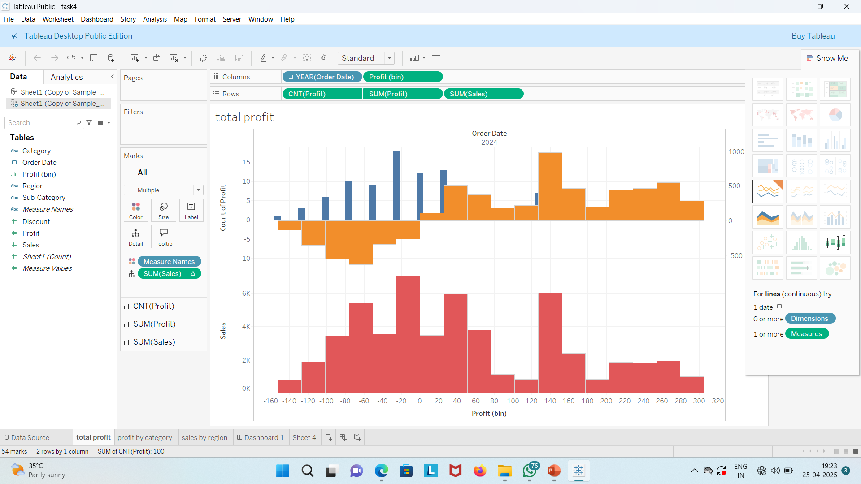
Key Insight: ”Total profit trends upwards,peaking months “

Slide 3
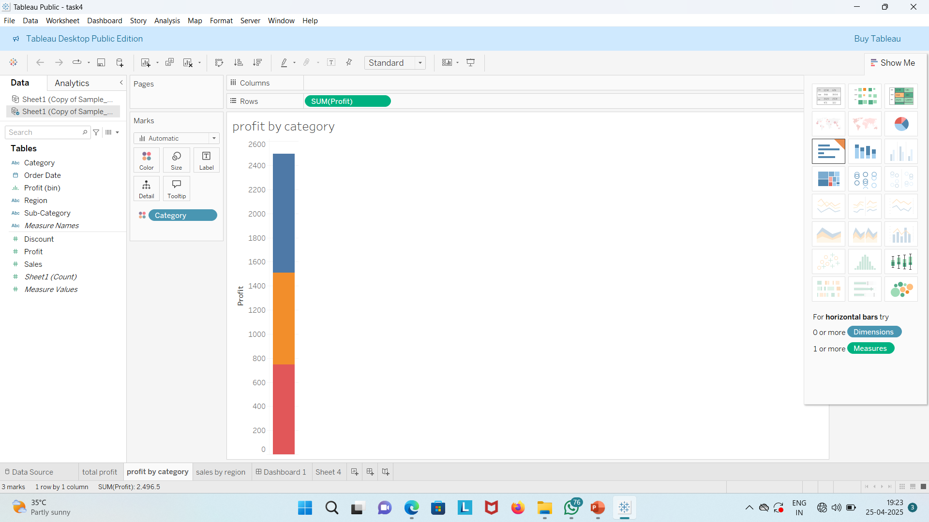
Key Insight: “category x contributes the most profits.”

Slide 4
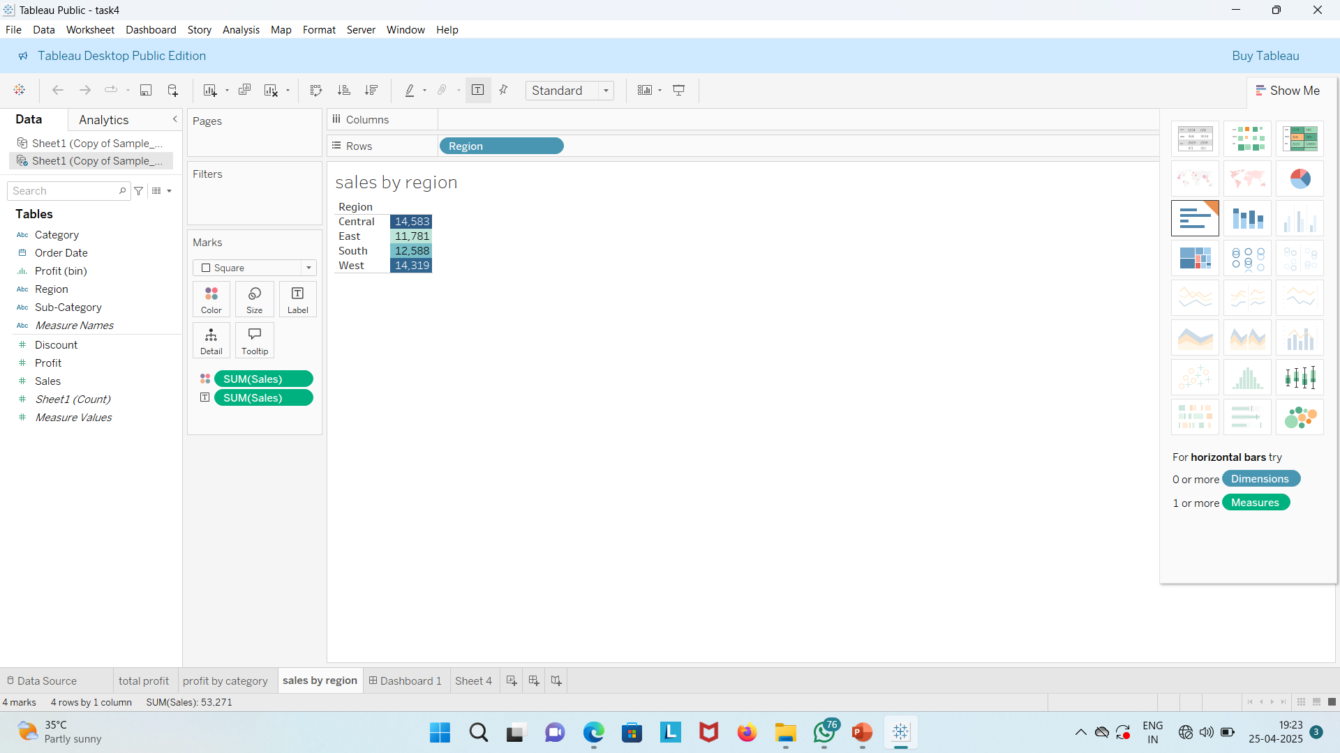
Key Insight : ”Region x leads in sales growth.”

Slide 5
CONCLUSION :
Key Takeway: Focus on booting sales in underperforming regions and categories.

